Slide 1

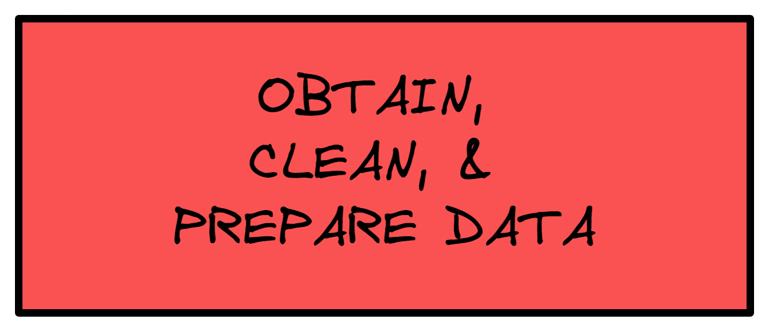

Slide 2
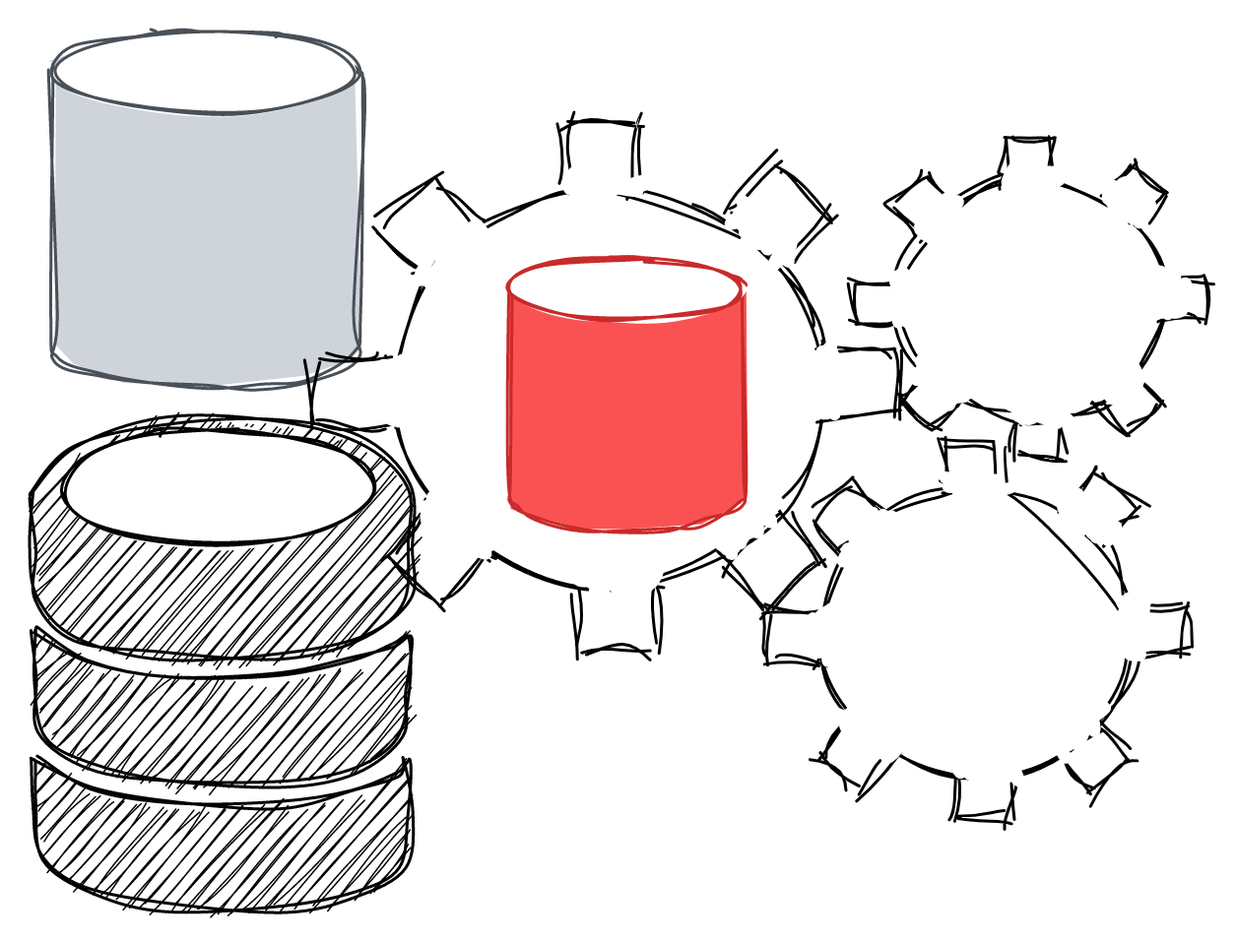
Data Science – Data Preparation
The Data
In this section, the focus will be more on the data and the "cleaning" process, rather than on the discovery and retrieval of it. In a typical data analysis, the data is contained in a structured format referred to as rectangular data, which shares in likeness to spreadsheets (e.g. Excel, CSV file) and traditional database tables. Fundamentally, it is a frame that represents the data in a two-dimensional matrix with rows indicating records (cases) and columns indicating feature (variables). Elements of Rectangular Data
Data frame, spreadsheet-like structure used to represent data for machine learning models.
Record, a row in the data frame
Synonyms- n, case, example, instance, observation, sample
Feature, a column in the data frame
Synonyms- X, attribute, input, predictor, variable, independent variable
Outcome, used as the target class in prediction problems
Synonyms- Y, output, response, target, dependent variable,
Notes:
Further Explanation
https://csu-r.github.io/Module2/rectangular-vs.-non-rectangular-data.html
https://towardsdatascience.com/types-of-structured-data-every-data-science-enthusiast-should-know-a656b95afbe2
https://machinelearningmastery.com/data-terminology-in-machine-learning/

Slide 3

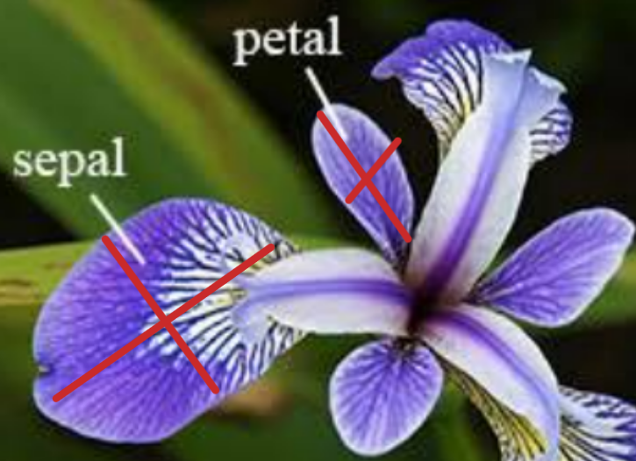
Data Preparation
Data Example
Dataset name: Iris Plants Database
Description: This is perhaps the best known database to be found in the pattern recognition literature. The data set was donated in 1988 by Michael Marshall but the data set was created by R.A. Fisher in 1936; Fisher's paper is a classic in the field and is referenced frequently to this day. The data set contains 3 classes of 50 instances each, where each class refers to a type of iris plant. There are a total of 5 attributes, with four of these being the measurements of the sepal and petals of each observation in the data set and the fifth being the class or species of Iris (Setosa, Versicolor, & Virginica) that each observation belongs to.
Predictors (X): sepal length in cm, sepal width in cm, petal length in cm, petal width in cm
Response (Y): class of iris plant (Setosa, Versicolor, Virginica)
Notes:
More info about dataset
https://www.angela1c.com/projects/iris_project/the-iris-dataset/
https://en.wikipedia.org/wiki/Iris_flower_data_set

Slide 4
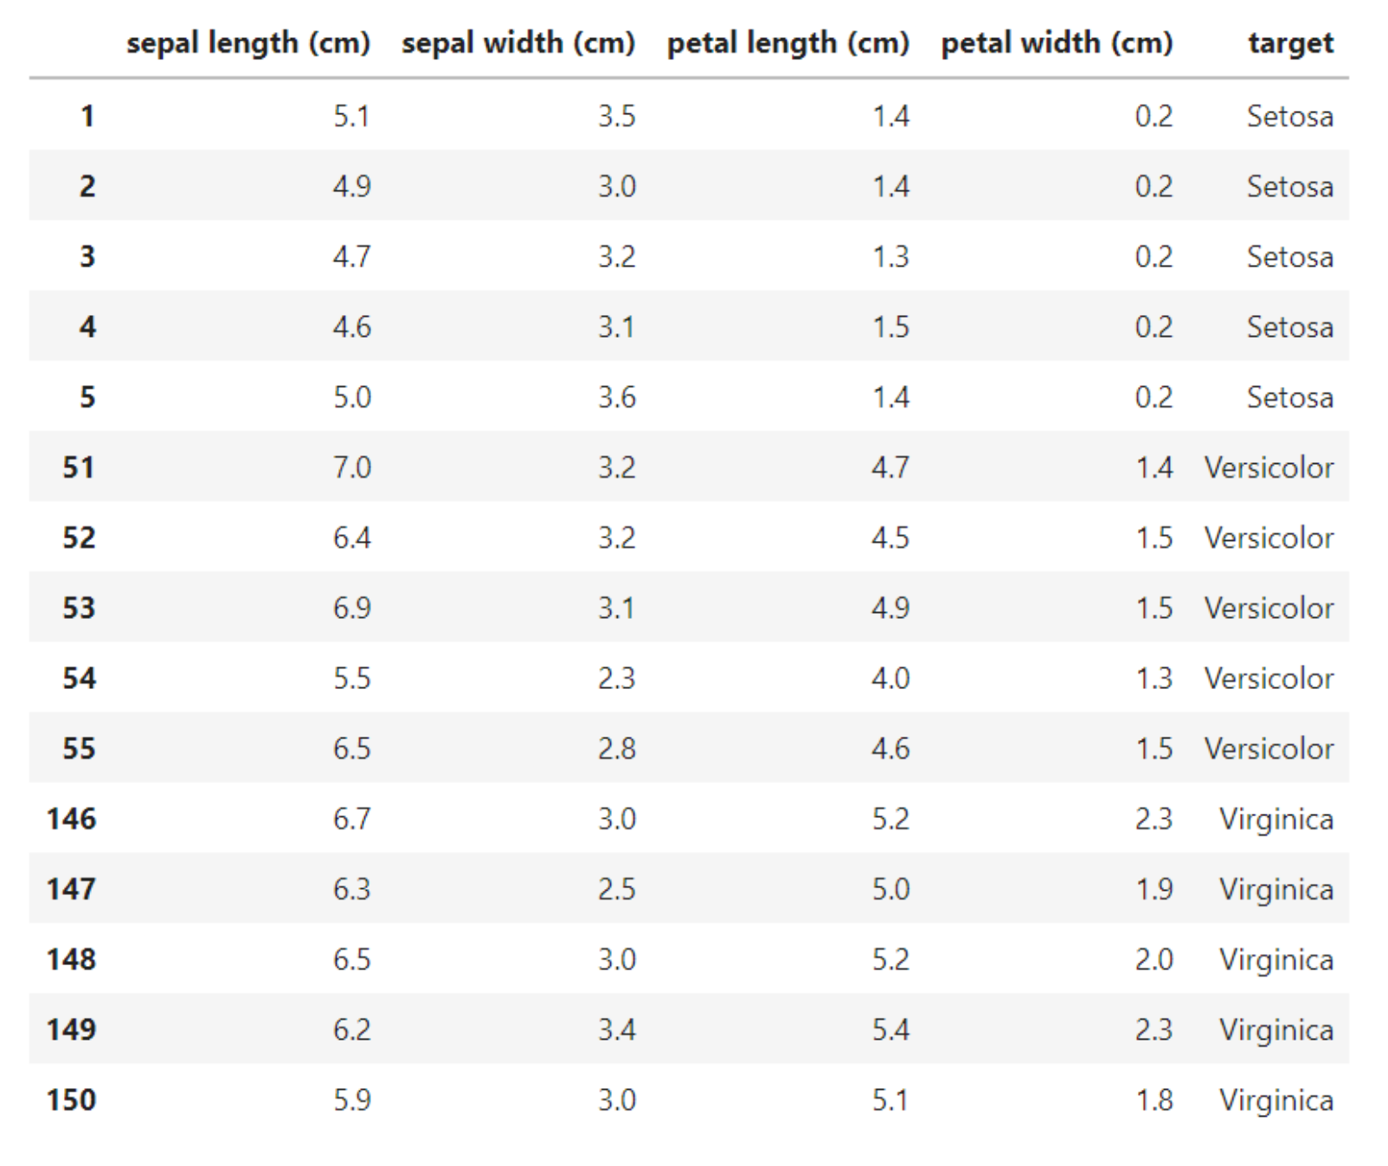
Data Preparation
Data Frame
Columns
Iris Plants Database
Rows
Notes:
More info about dataset
https://www.angela1c.com/projects/iris_project/the-iris-dataset/
https://en.wikipedia.org/wiki/Iris_flower_data_set

Slide 5
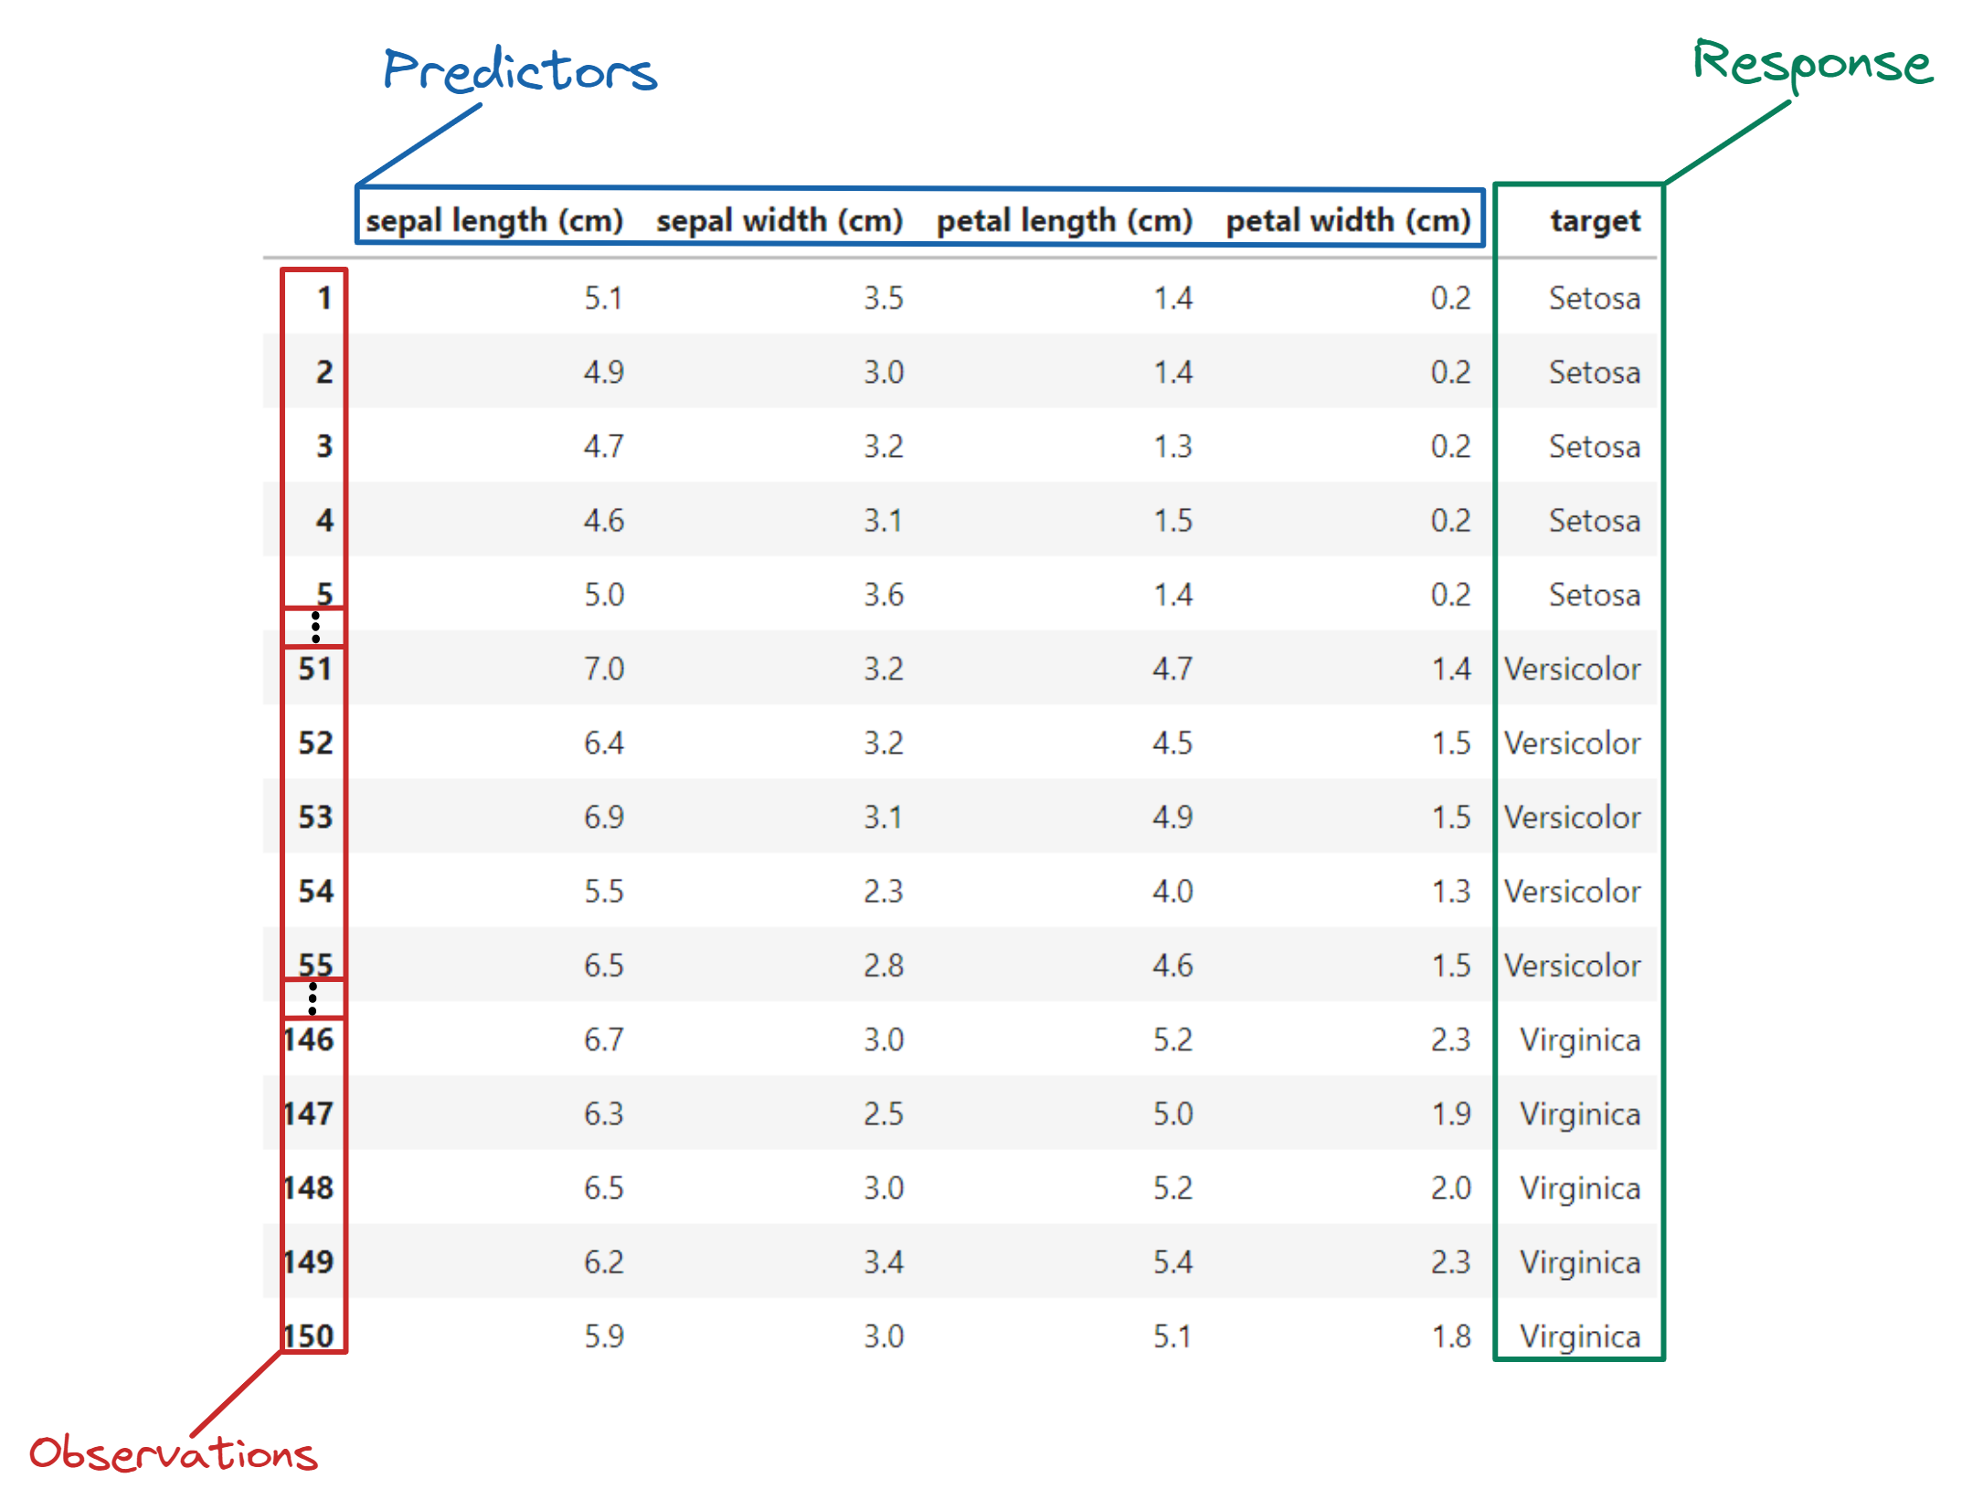
Data Preparation
Columns
Iris Plants Database
Rows
Notes:
More info about dataset
https://www.angela1c.com/projects/iris_project/the-iris-dataset/
https://en.wikipedia.org/wiki/Iris_flower_data_set

Slide 6
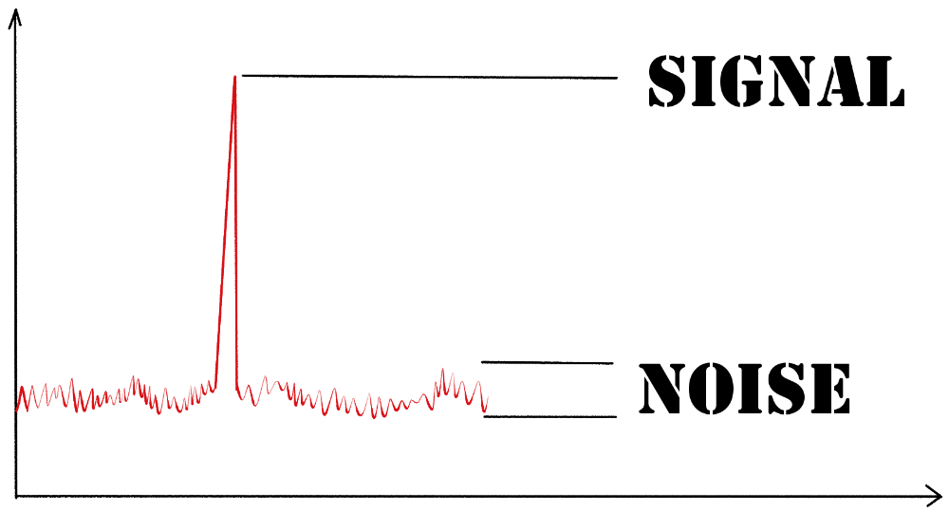
Data Science – Data Preparation
Signal-to-Ratio
"Signal-to-noise ratio (SNR or S/N) is a measure used in science and engineering that compares the level of a desired signal to the level of background noise. A ratio higher than 1:1 (greater than 0 ) indicates more signal than noise." -Wiki
Building on the same idea, we can think of data as data= true signal + noise; this is often referred to as noisy data- "data with a large amount of additional meaningless information in it (noise)."
Random, an unavoidable problem; errors introduced by measurement tools and errors introduced by processing or experts when the data is gathered.
Systematic, an error (bias) that is consistently propagated throughout the data.
"Noisy data can adversely affect the results of any data analysis and skew conclusions if not handled properly." Wiki
By FraGue Moser-Kindler
Notes:
Further Explanation
https://www.techtarget.com/searchbusinessanalytics/definition/noisy-data
Random noise is an unavoidable problem. It affects the data collection and data preparation processes, where errors commonly occur. Noise has two main sources: errors introduced by measurement tools and random errors introduced by processing or by experts when the data is gathered
Hence, it is imperative to look for ways to minimize the effect of noise in the data, in order to have robust analysis, and conclusions.
Class vs Attribute noise
https://link.springer.com/article/10.1007/s10462-004-0751-8

Slide 7
Data Science – Data Preparation
Random Noise
Random noise can be found everywhere. For example, biological data is often characterized by the presence of redundant and noisy examples due to errors during data collection, as a result of laboratorial sample contamination.
Mislabeled cases, instances incorrectly classiﬁed in the data set generation process.
Redundant data, instances that form clusters in the data set and can be represented by others.
Outliers, instances too distinct when compared to the other examples of the data set.
Borderlines, instances close to the decision border. These are quite unreliable, since even a small amount of noise can move them to the wrong side of the decision border;
Safe cases, remaining instances, which should be saved for the learning process
Notes:
Further Explanation
Depending on the problem, even apparently good data might turn out to be unnecessary to the question that one is trying to answer. As a result, noise can be (in the data science space) is unwanted data items, features or records which don’t help in explaining the feature itself, or the relationship between feature & target. Noise often causes the algorithms to miss out patterns in the data.
//more like feature selection (https://yusout.com/2019/04/29/dealing-with-noisy-data-in-data-science/ )
Noise in tabular data can be of three types:
Anomalies in certain data items (Noise 1: certain anomalies in features & target)
Features that don’t help in explaining the target (Noise 2: irrelevant/weak features)
Records which don’t follow the form or relation which rest of the records do (Noise 3: noisy records)

Slide 8
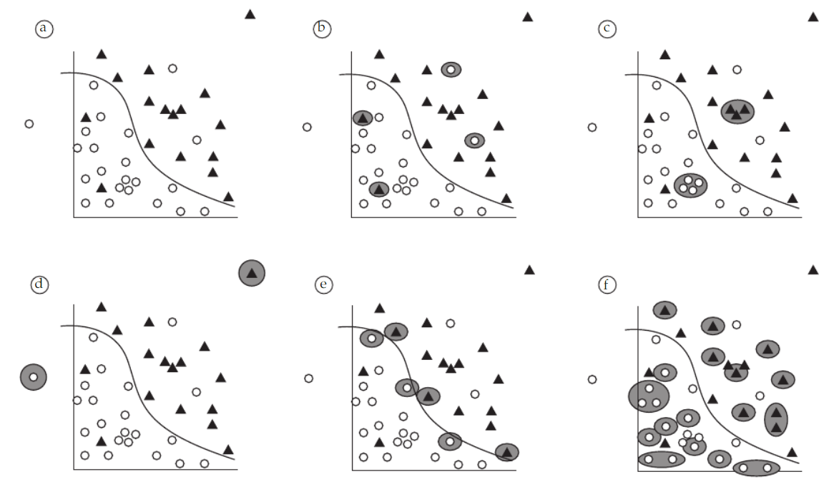
Data Science – Data Preparation
Random Noise
a) Simple data set
b) Mislabeled cases
c) Redundant data
d) Outliers
e) Borderlines
f) Safe cases
from Evaluation of noise reduction techniques in the splice junction recognition problem (2004)
Notes:
Further Explanation

Slide 9
Data Science – Data Preparation
Systematic Error (Bias)
Bias, “a particular tendency, trend, inclination, feeling, or opinion, especially one that is preconceived or unreasoned.” - Dictionary
Common Types
Reporting bias, the tendency to document unusual events rather than all events.
Selection bias, a sample (e.g. dataset) that fails to be representative of the entire population that is attempting to generalize.
Non-response- bias, lack of representation as a result of lack of response
Sampling bias, lack randomization
Group bias, the tendency to generalize ideas beyond individuals and perpetuate them to entire groups to which they might belong to.
Implicit bias, one’s own assumptions about the world and its actors
Notes:
Further Explanation
Examples @ https://developers.google.com/machine-learning/crash-course/fairness/types-of-bias

Slide 10
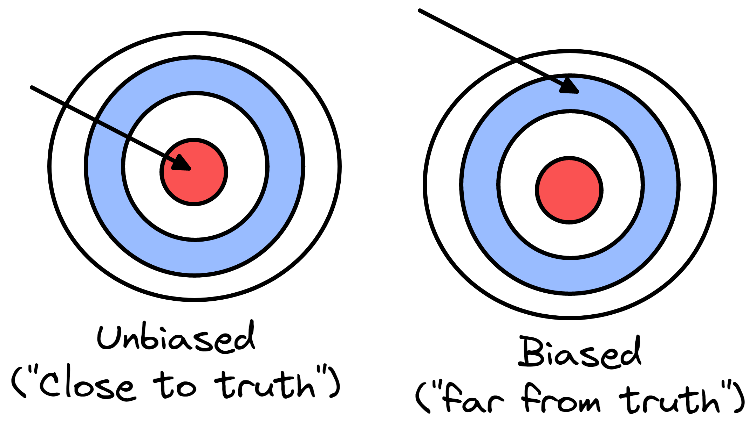
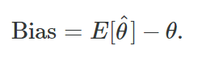
Data Science – Data Preparation
Systematic Error (Bias)
In data science (machine learning), bias "occurs when an algorithm produces results that are systemically prejudiced due to erroneous assumptions in the machine learning process."
In other word, "bias refers to the error that is introduced by approximating a real-life problem, which may be extremely complicated, by a much simpler model." As a result, the model that one uses might rely on assumptions that are far too simplistic to grasp the complexities within a system/data, and fail to discover the useful relationships/patterns of interest.
Mathematically, bias is represented as the difference between a value predicted by a model and the correct target value.
How far from the truth?
Notes:
Further Explanation
https://www.techtarget.com/searchenterpriseai/definition/machine-learning-bias-algorithm-bias-or-AI-bias
https://medium.com/swlh/the-bias-variance-tradeoff-f24253c0ab45
"How far one is from the truth?"

Slide 11
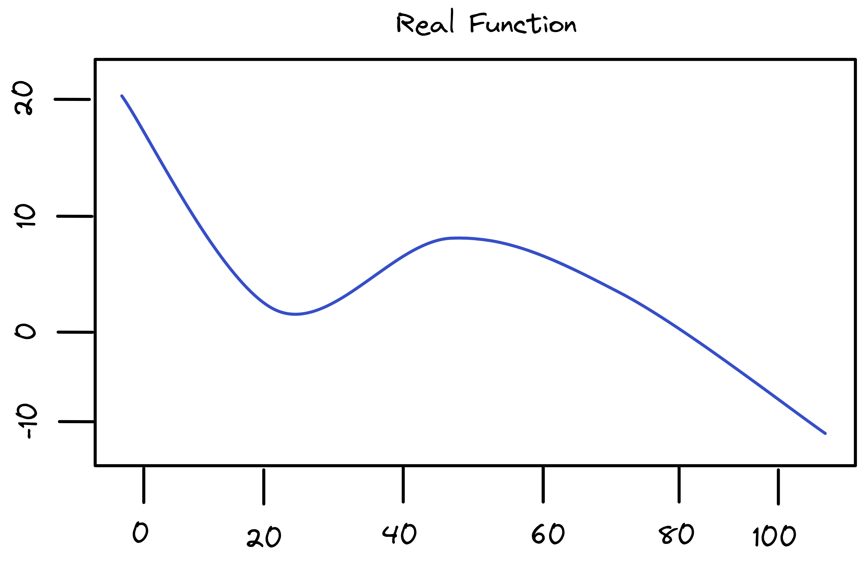
Data Science – Data Preparation
Systematic Error (Bias)
For example, linear regression assumes that there is a linear relationship in the data. It is unlikely that any real-life problem truly has such a simple linear relationship, and so performing linear regression will undoubtedly result in some bias. This is more apparent when the relationships are nonlinear.
Notes:
Further Explanation

Slide 12
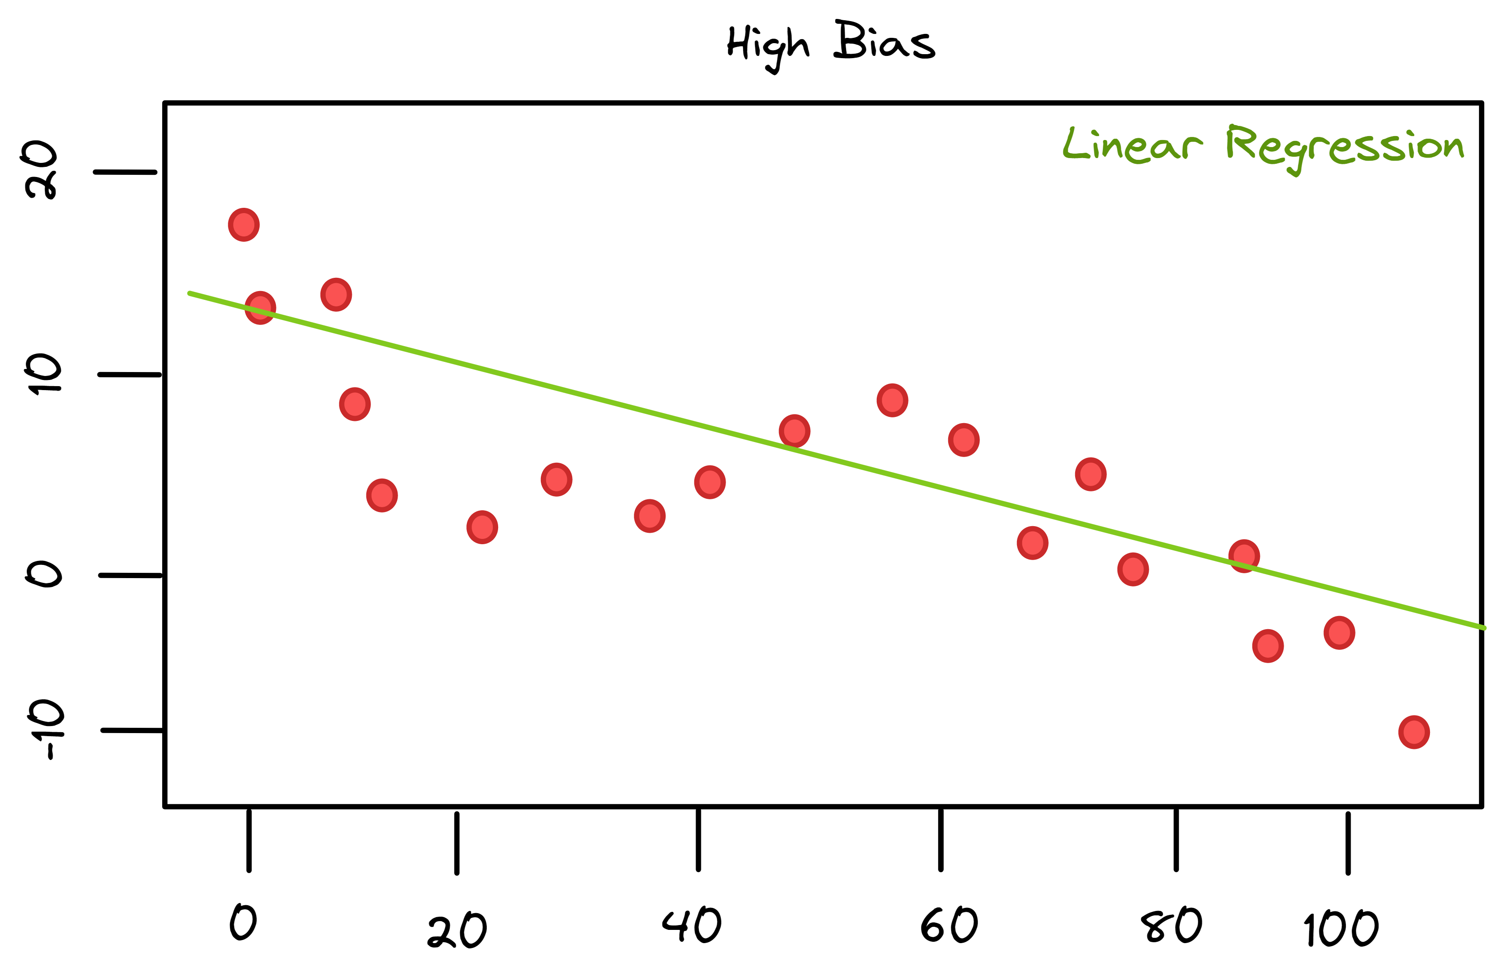
Data Science – Data Preparation
Systematic Error (Bias)
A linear regression model, will assume that the data follow a linear relationship.
Notes:
Further Explanation

Slide 13
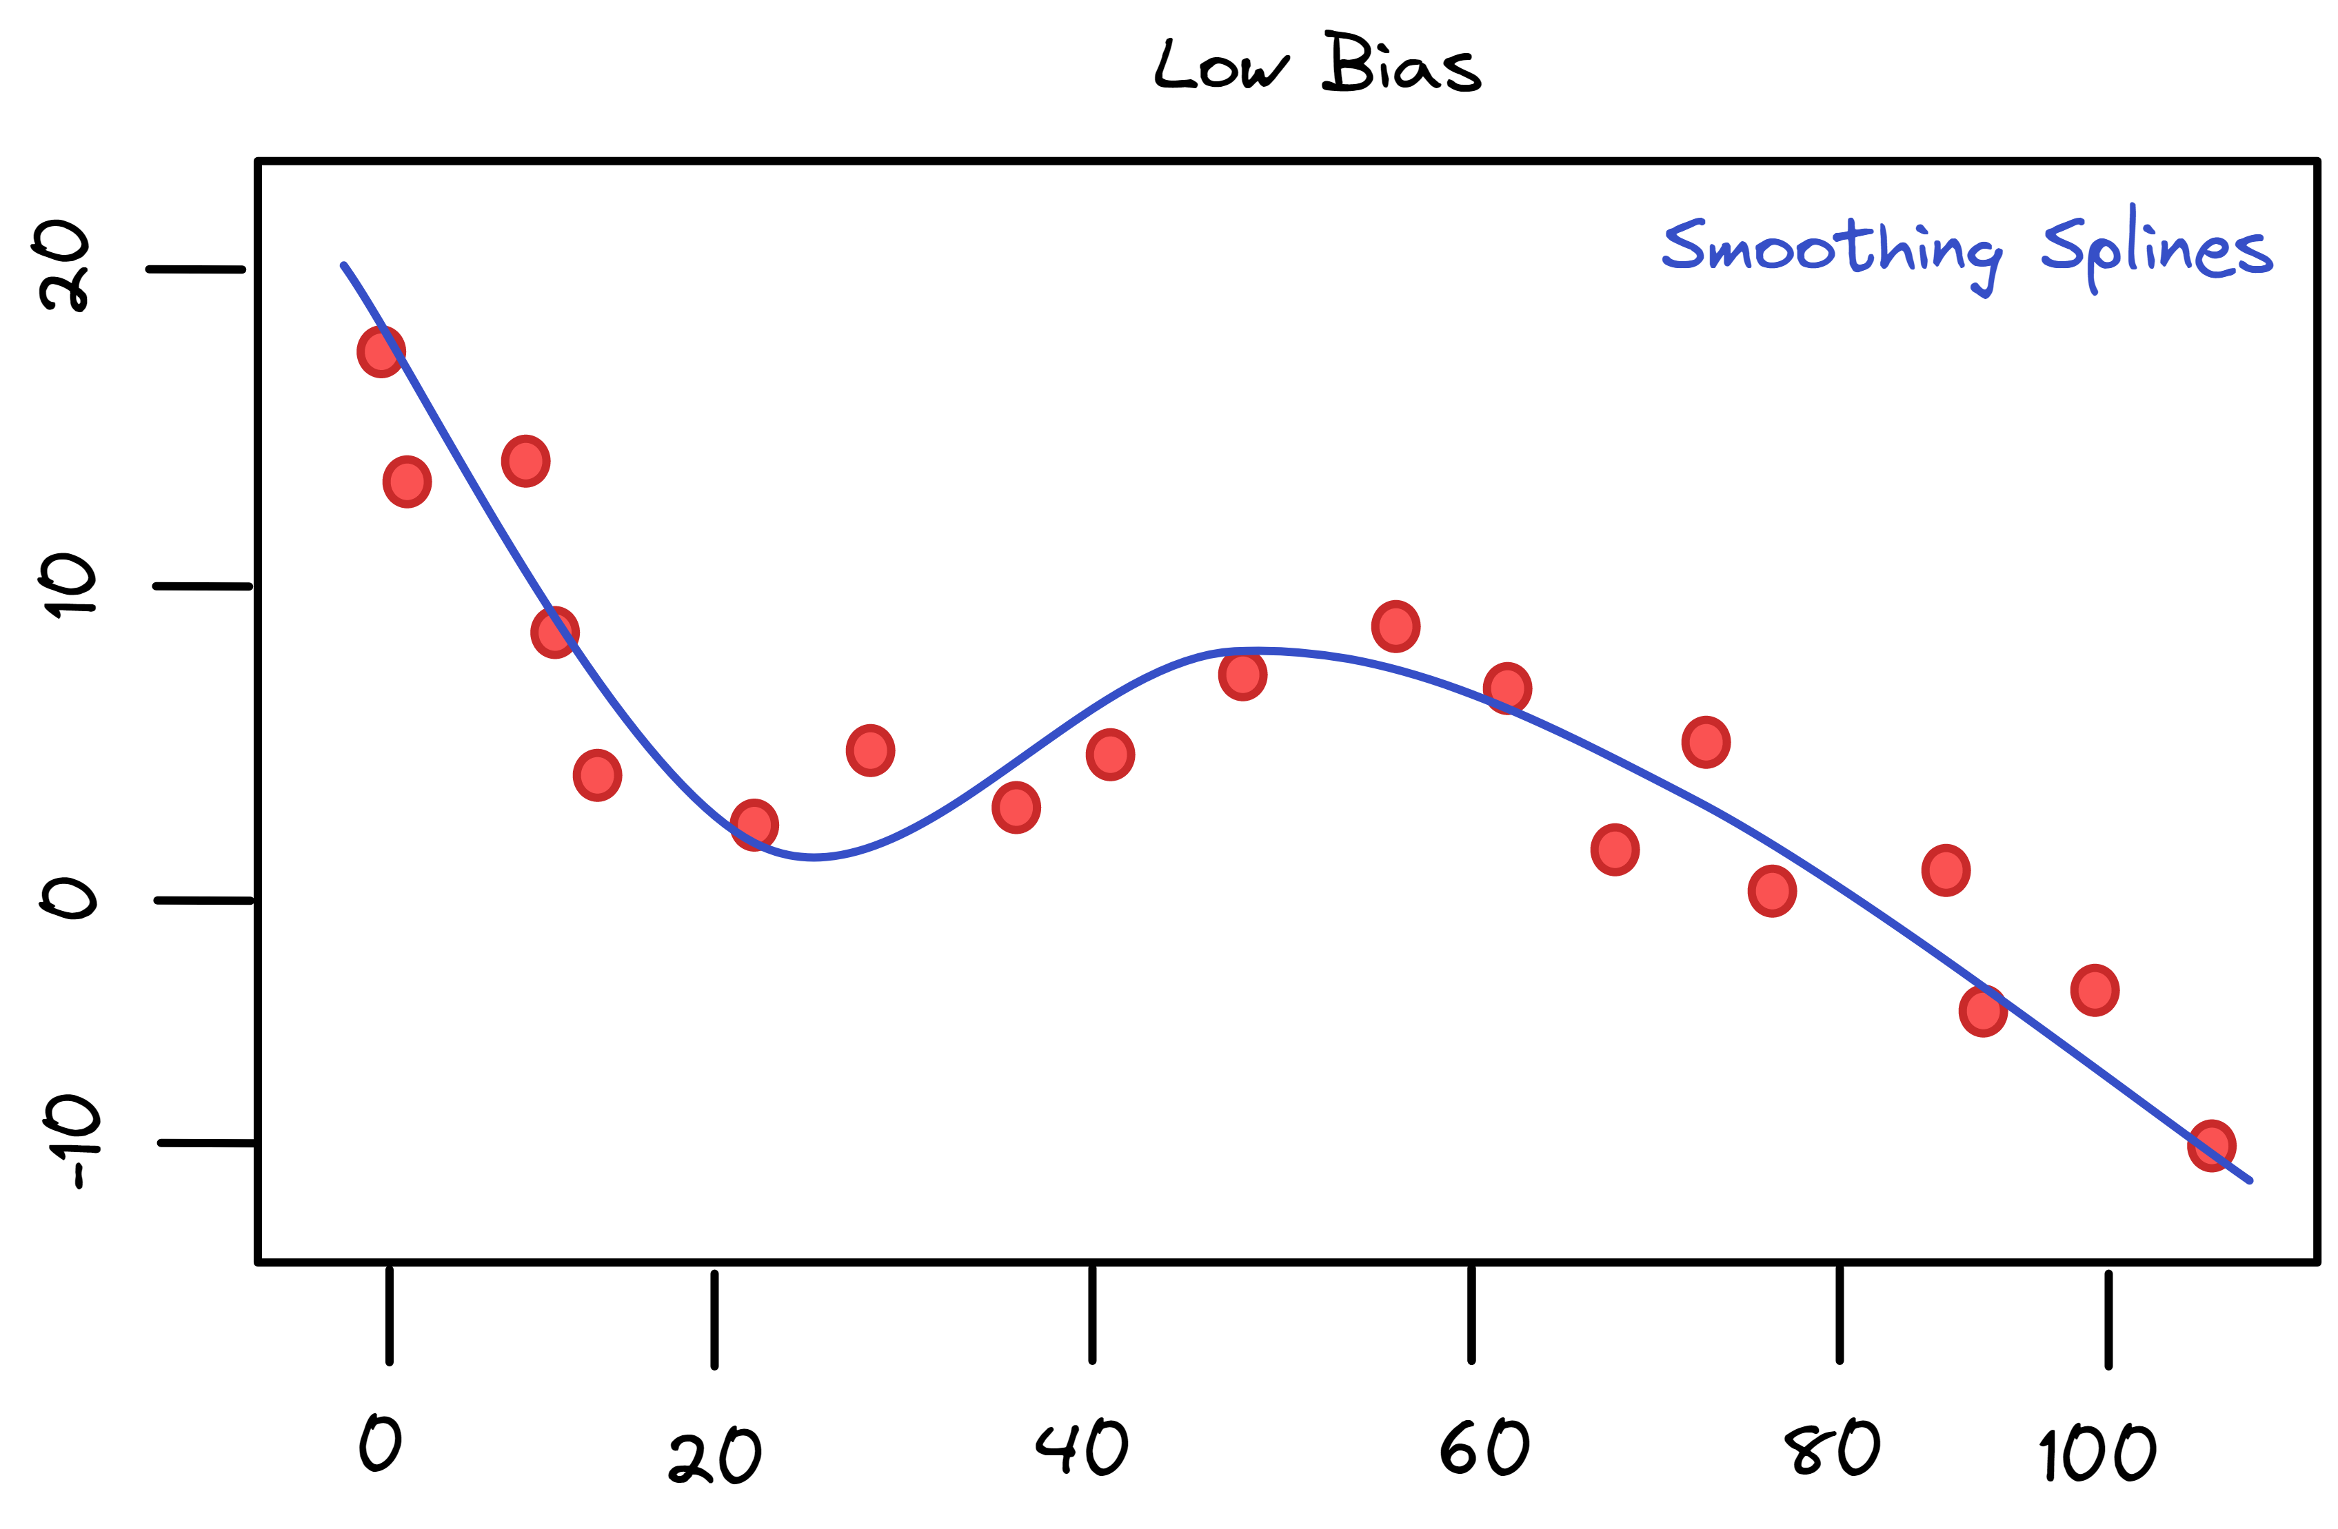
Data Science – Data Preparation
Systematic Error (Bias)
A smoothing spline model, will assume that the data follow a non-linear relationship.
Notes:
Further Explanation

Slide 14
Data Science – Data Preparation
High Bias = Underfitting
When the model is too simplistic, such that it makes strong assumptions, imposes a particular structure on the dataset (e.g. linear structure), and neglects to fully understand the relationships within it- the model can be said to be underfitting (i.e. oversimplifying).
Typically,
A high bias model includes more assumptions about the target function or end result. Now, model with more assumptions, tends to be easier to understand and in general less complex. Hence, less flexible models result in more bias.
A low bias model incorporates fewer assumptions about the target function. On the other hand, models with fewer assumption tend to be more complicated given, that they allow for different kinds of relationships to be represented. Hence, more flexible models result in less bias.
"Underfitting occurs when the model fails to portray the relationships of the data."
Notes:
Further Resources
https://machinelearningmastery.com/gentle-introduction-to-the-bias-variance-trade-off-in-machine-learning/
https://www.educative.io/edpresso/what-is-the-tradeoff-between-bias-and-variance
Characteristics of a High Bias Model
Underfitting: A model with High Bias tends to underfit the data as it oversimplifies the solution by failing to learn how to train the data efficiently. This results in a linear function.
Oversimplification: Due to the model being too simple, the biased model is unable to learn complex features of a training data, thus, making it inefficient when solving complex problems.
Low Training Accuracy: Due to the inability to correctly process training data, the biased model shows high-training loss resulting in low-training accuracy.

Slide 15
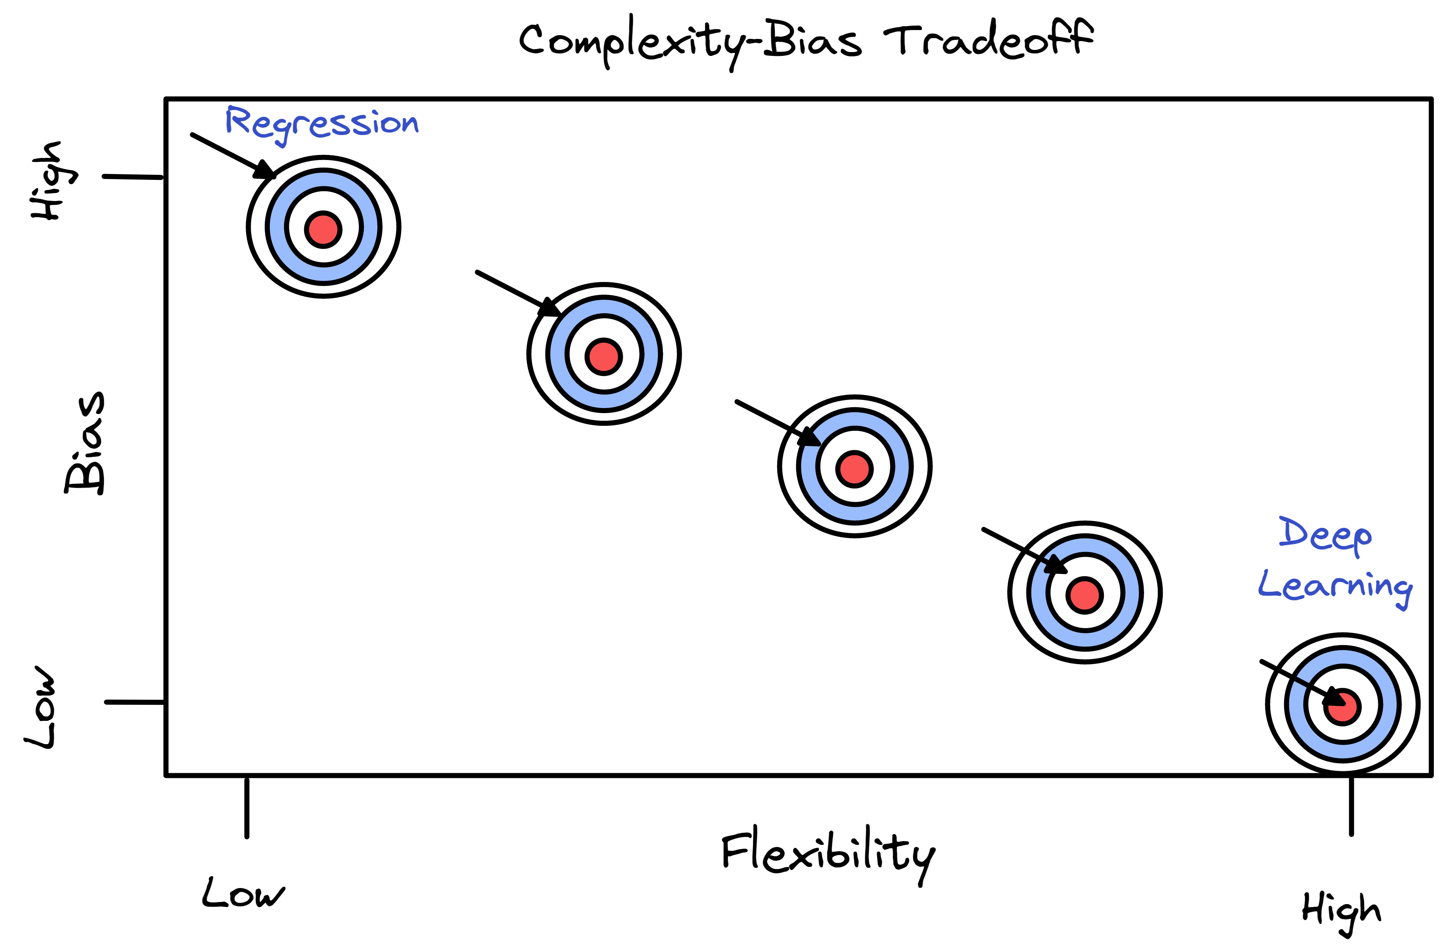
Data Science – Data Preparation
Complexity-Interpretability Tradeoff

Slide 16
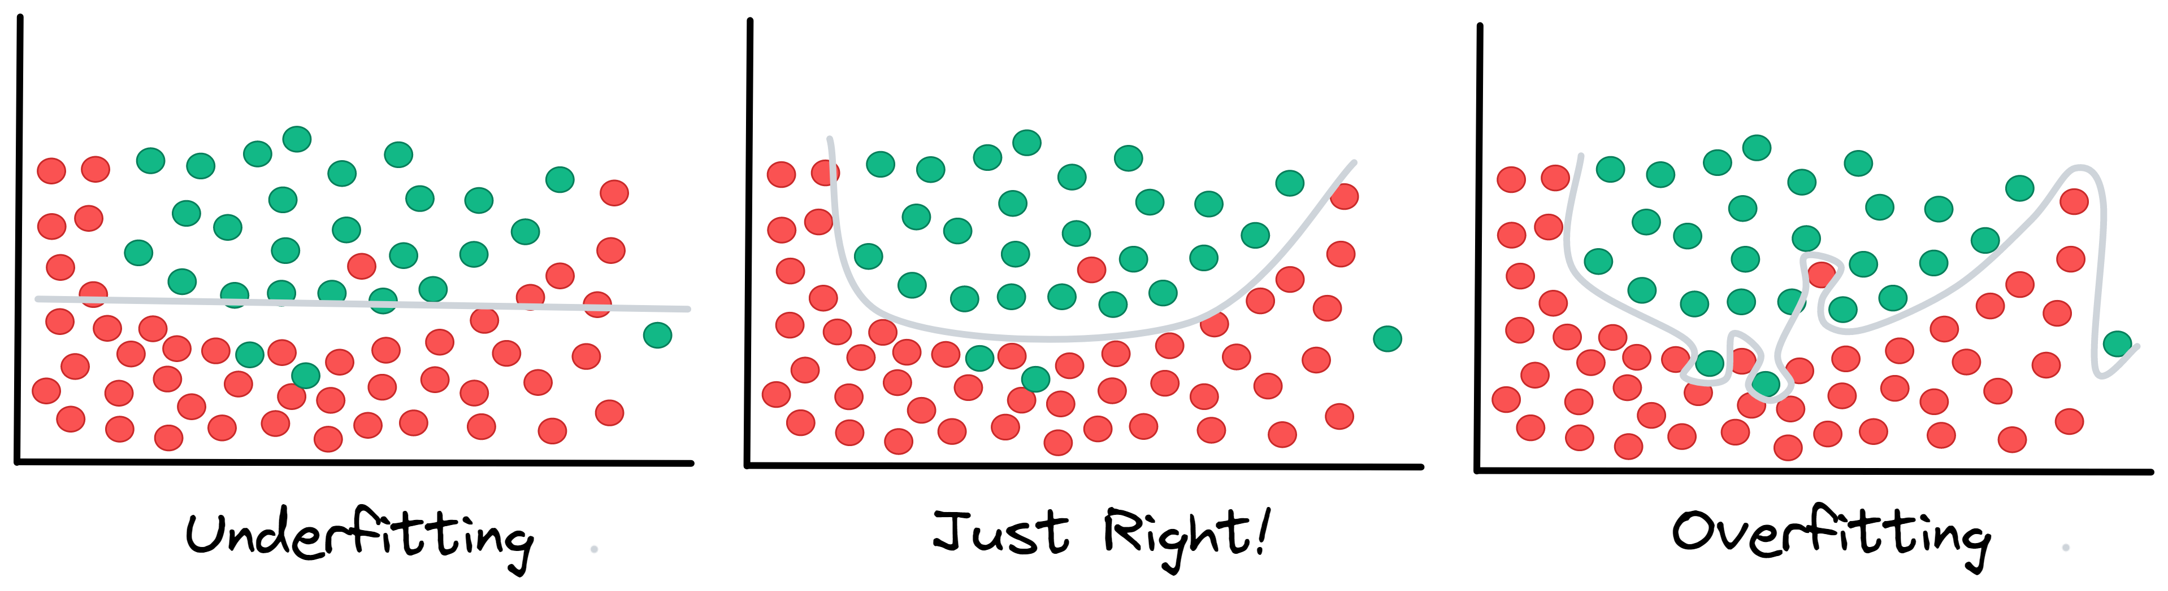
Data Science – Data Preparation
Complex= less interpretable;
Simple= more interpretable;
Complexity, Bias, & Fit
Complex models tend to have less bias (closer to truth), yet there are subject to overfitting.
Simpler model tend to have more bias (further to truth), yet they are subject to underfitting.
"Not reading enough into the data!"
"Sweet spot!"
"Reading too much into the noise!"

Slide 17
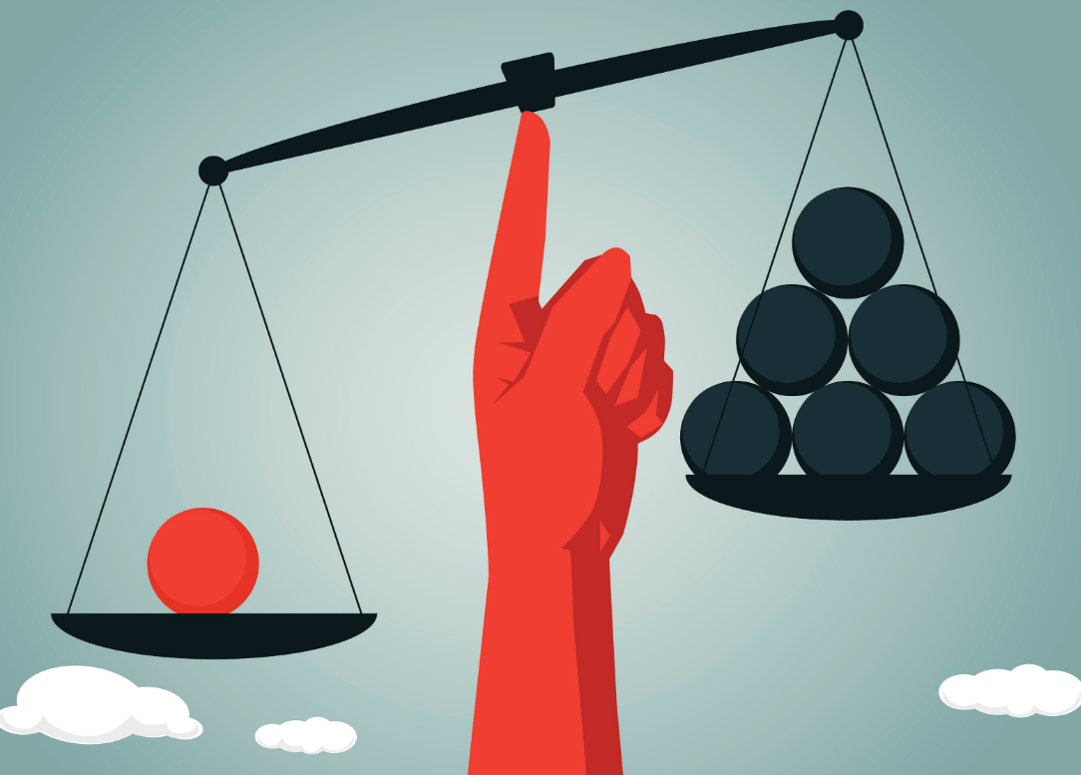
Data Science – Data Preparation
Reducing Bias
Representative data, select data that is appropriately representative and large enough to counteract common types of machine learning bias, such as sample bias and prejudice bias. A good dataset provides enough diversity to cover all possible groups and outcomes.
Change model, different models have different strengths and weaknesses that work great for certain datasets, and are better not used for others in accordance with the assumptions that they entail. As a result, one should strive to use a model that reduces bias (within reason) and is useful.
More data (features), sometimes one might not have enough data in terms of important variables that might explain or be responsible for particular trends.
Parameter tuning, this requires an understanding of the model and model parameters. Every model has a list of parameters which it takes as inputs. Tweaking these parameters may give you the desired results. You can also build your own algorithms from scratch.
Notes:
Further Explanation
https://www.techtarget.com/searchenterpriseai/definition/machine-learning-bias-algorithm-bias-or-AI-bias
https://medium.com/swlh/the-bias-variance-tradeoff-f24253c0ab45

Slide 18
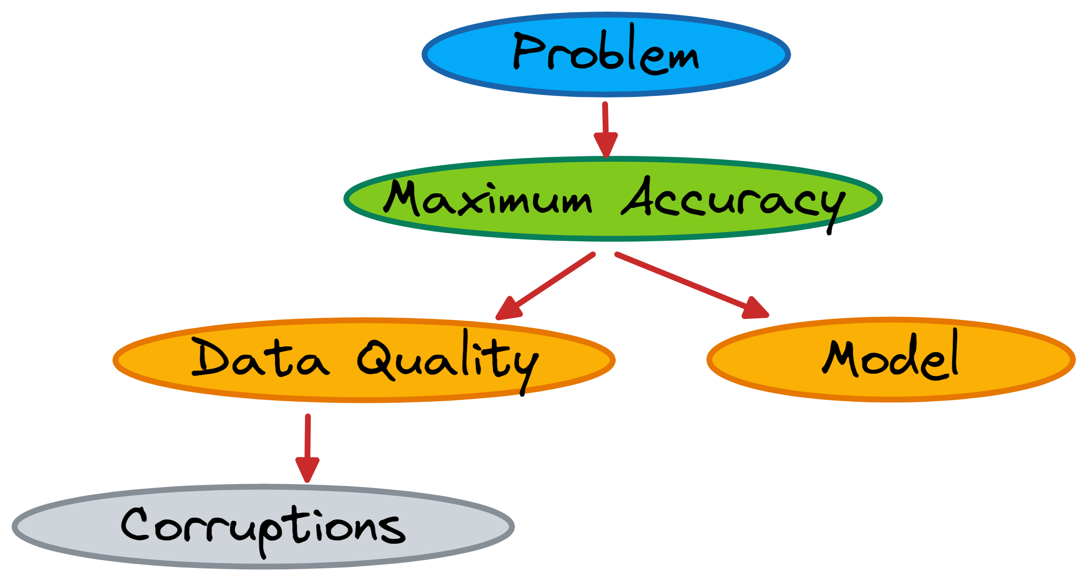
Data Science – Data Preparation
The Effect of Noise
When it comes to data science problems (prediction/inference), one tends to pick on models that favor/maximize accuracy and minimize error; this in turn heavily depends on the quality of the data. The occurrences of noisy data in data set can significantly impact results and led to decreased accuracy. Therefore, any analysis requires the ability to identify, handle, and mitigate noise in data.
Adopted from Noisy Data in Data Mining
Notes:
Further Explanation
https://sci2s.ugr.es/noisydata
https://www.sciencedirect.com/science/article/pii/S1877050919318575

Slide 19
Data Science – Data Preparation
The Effect of Noise
When it comes to data science problems (prediction/inference), one tends to pick on models that favor/maximize accuracy and minimize error; this in turn heavily depends on the quality of the data. The occurrences of noisy data in data set can significantly impact results and led to decreased accuracy. Therefore, any analysis requires the ability to identify, handle, and mitigate noise in data.
??
Adopted from Noisy Data in Data Mining
Notes:
Further Explanation
https://sci2s.ugr.es/noisydata
https://www.sciencedirect.com/science/article/pii/S1877050919318575

Slide 20
Data Science – Data Preparation
What is Data Pre-processing?
“Data preprocessing can refer to manipulation or dropping of data before it is used in order to ensure or enhance performance.”
Data-gathering methods are often loosely controlled, resulting in out-of-range values (e.g., Income: −100), impossible data combinations (e.g., Sex: Male, Pregnant: Yes), and missing values, etc..., as a result data must go through a of refinement process in order to deal with the present impurities.
"Data preparation and filtering steps can take considerable amount of time."
Often, data cleaning and preparation is the most time consuming task in the analysis pipeline.
"Often, data preprocessing is the most important phase of a machine learning project."
Analyzing unprocessed data can affect the analysis and produce misleading results. If there is much noisy and unreliable data, then knowledge discovery during the analyzing phase is more difficult.
Notes:
Further Explanation

Slide 21
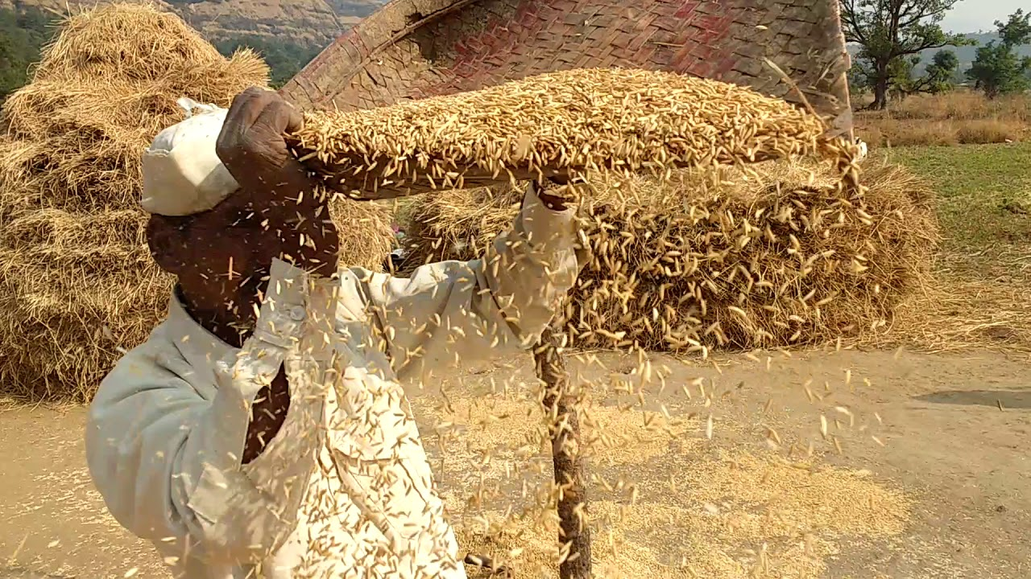
Data Science – Data Preparation
What is Data Pre-Processing?
"Separating the wheat from the chaff."
from YouTube
Notes:
Further Explanation

Slide 22
Data Science – Data Preparation
Good Data
What is Data Pre-Processing?
"Separating the wheat from the chaff."
Pre-Processing
Bad Data
from YouTube
Notes:
Further Explanation

Slide 23
Data Science – Data Preparation
What is Data Pre-processing?
As with many topics, pre-processing is a broad topic, that is referenced and displayed in different packaging, for example (next slid);
For our purpose, we will look at pre-processing as two high level main tasks that comprise most of the other subdivisions (slide next next).
Notes:
Further Explanation
Data preprocessing includes data preparation, compounded by integration, cleaning, normalization and transformation of data; and data reduction tasks; such as feature selection, instance selection, discretization, etc. The result expected after a reliable chaining of data preprocessing tasks is a final dataset, which can be considered correct and useful for further data mining algorithms
-- Book Data Preprocessing in Data Mining by Garcia (2014)
Mention: https://www.frontiersin.org/articles/10.3389/fenrg.2021.652801/full

Slide 24
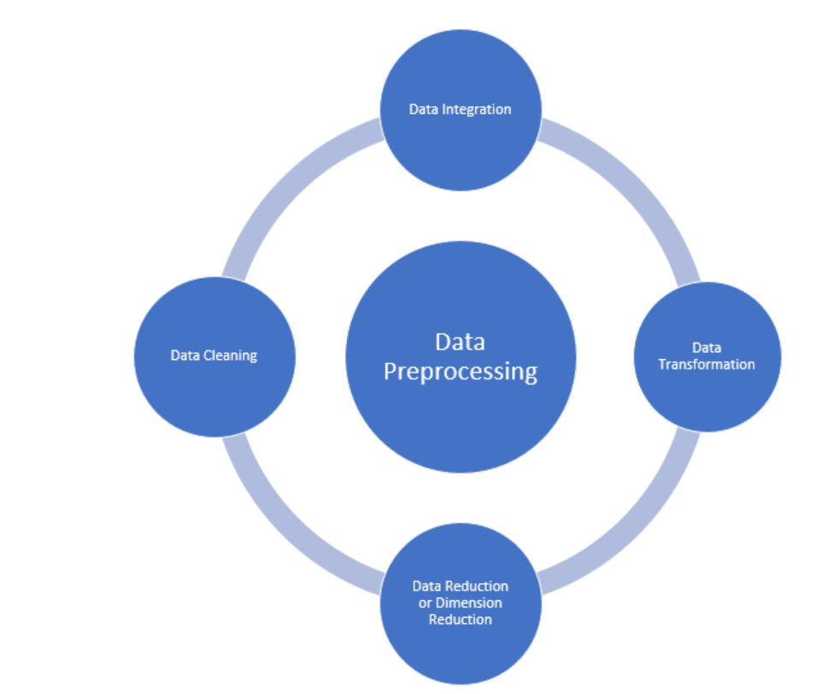
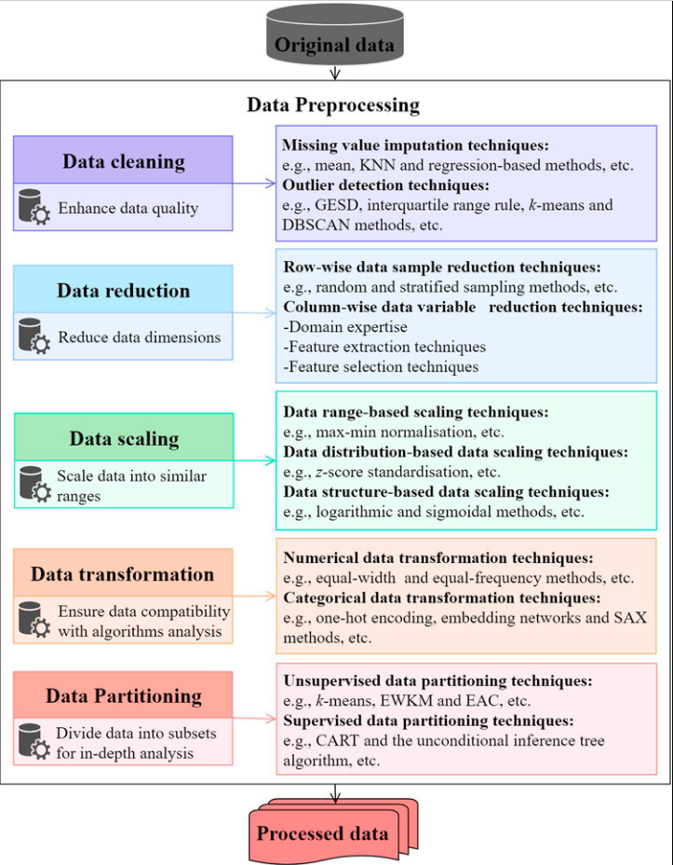
PRE-PROCESSING
https://www.frontiersin.org/articles/10.3389/fenrg.2021.652801/full
https://www.analyticsvidhya.com/blog/2021/08/data-preprocessing-in-data-mining-a-hands-on-guide/

Slide 25
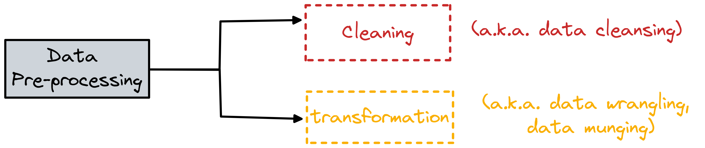
Data Science – Data Preparation
What is Data Pre-processing?
“Data preprocessing can refer to dropping or manipulating of data before it is used in order to ensure or enhance performance.” -Wiki
Cleaning
Transformation
Notes:
Further Explanation
Data preprocessing includes data preparation, compounded by integration, cleaning, normalization and transformation of data; and data reduction tasks; such as feature selection, instance selection, discretization, etc. The result expected after a reliable chaining of data preprocessing tasks is a final dataset, which can be considered correct and useful for further data mining algorithms
-- Book Data Preprocessing in Data Mining by Garcia (2014)
Mention: https://www.frontiersin.org/articles/10.3389/fenrg.2021.652801/full

Slide 26
Data Science – Data Preparation
What is Data Pre-processing?
“Data cleaning is the process that removes data that does not belong in your dataset.”
Data cleaning is the process of detecting and fixing, removing incorrect, corrupted, incorrectly formatted, duplicate, or incomplete data within a dataset. When combining multiple data sources, there are many opportunities for data to be duplicated or mislabeled.
“Data transformation is the process of converting data from one format or structure into another.”
Transformation, also known as data wrangling, or data munging, is the process of mapping data from one "raw" data form into another format with the intent of making it more appropriate. Transformations usually are the result of a need that arises from using a particular model. For example, often times text data is transformed into a numerical format in order to allow traditional models/algorithms to have faster processing time: the information is the same, the format changes.
Notes:
Further Explanation
https://en.wikipedia.org/wiki/Data_pre-processing
https://en.wikipedia.org/wiki/Data_cleansing
https://en.wikipedia.org/wiki/Data_wrangling
https://www.sisense.com/glossary/data-cleaning/

Slide 27
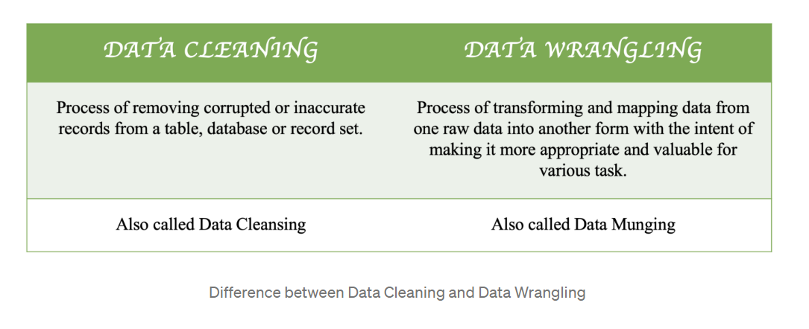
Data Science – Data Preparation
Cleaning vs Wrangling
from Dr. Monica
Notes:
Further Explanation

Slide 28
Data Science – Data Preparation
Cleaning vs Wrangling Operations
Cleaning
Remove irrelevant observations
Remove duplicates
Fix structural errors ( dates, numbers, lower case letters, type conversions, same convention)
Handle missing data
Sanity checks (conflicting observations)
Wrangling
Dataset ops (sort, select, merge, group)
Standardization
Normalization
Outliers
Encoding (one hot encoding, dummy variables, …)
Dimensionality reduction
Notes:
Further Explanation
https://research.aimultiple.com/data-cleaning/
https://towardsdatascience.com/the-ultimate-guide-to-data-cleaning-3969843991d4
https://www.techtarget.com/searchdatamanagement/definition/data-scrubbing
https://elitedatascience.com/data-cleaning
Wrangling
https://opendatascience.com/data-wrangling-how-to-prepare-your-data/

Slide 29
Explain
- Missing Data techniques (Imputation, deletion)
- Encoding (One hot encoding, dummy variables )
Notes:
Further Explanation

Slide 30

Data Science
Still Confused?
Watch this video.
Notes:
Further Resources
https://www.youtube.com/watch?v=UiV7wf36je0&t=145s & https://www.techtarget.com/searchenterpriseai/definition/data-science
https://www.youtube.com/watch?v=uswU1s3M2VE

Slide 31
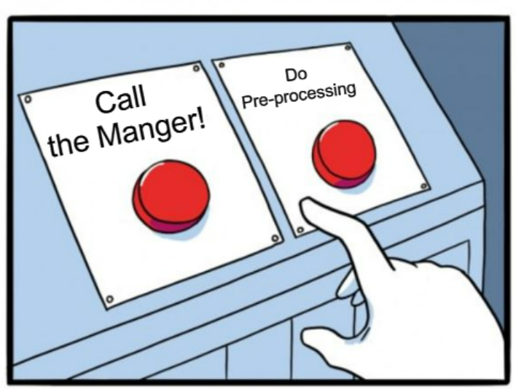
Data Science – Data Preparation
How much time of analysis is spent at each step?
"Data preparation and filtering steps can take considerable amount of time."
Often, data cleaning and preparation is the most time consuming task in the analysis pipeline.
"Is pre-processing really necessary? I'd like to skip to analysis, if possible. Where's the manager?"
Notes:
Further Explanation

Slide 32
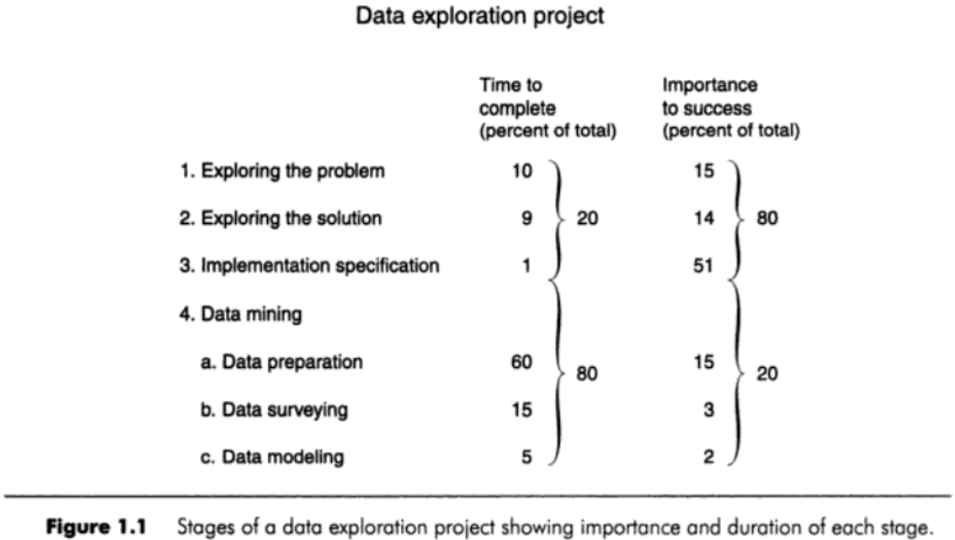
Data Science – Data Preparation
Time Spent Pre-Processing
from Dorian Boyle (1999)
Notes:
Further Explanation

Slide 33
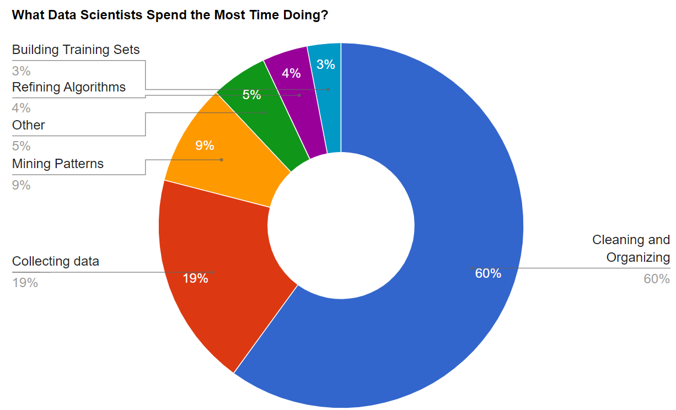
Data Science – Data Preparation
How much time of analysis is spent at each step?
An article from Forbes, "Cleaning Big Data: Most Time-Consuming, Least Enjoyable Data Science Task, Survey" (2016) reports that about 80% of data scientists time revolves around data cleaning and collection.
Notes:
Further Explanation
Most of the time is spent on “massaging data” rather than analysis or other “cool” stuff.
Considering that another 20% of the time is used to collect the data, on average about 80% is work done exclusively with the data without any kind of analysis

Slide 34
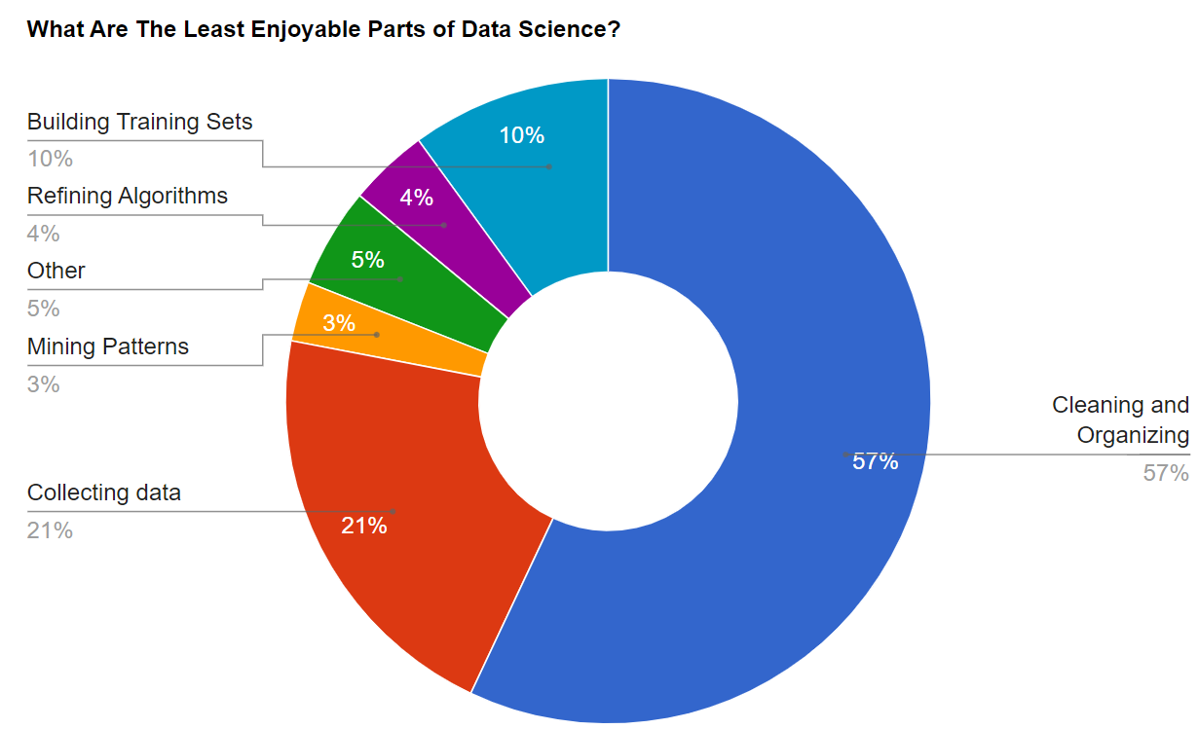
Data Science – Data Preparation
How much time of analysis is spent at each step?
The same article continues on reporting the least enjoyable tasks of a data scientists- data cleaning and collection (80%).
Notes:
Further Explanation
Most of the time is spent on “massaging data” rather than analysis or other “cool” stuff.
Considering that another 20% of the time is used to collect the data, on average about 80% is work done exclusively with the data without any kind of analysis

Slide 35
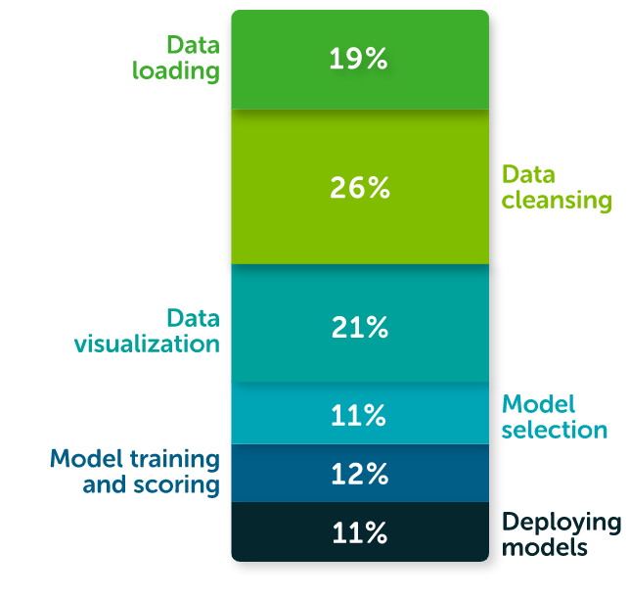
Data Science – Data Preparation
How much time of analysis is spent at each step?
Another more recent study (2020) commissioned by Anaconda, an open source project dedicated to the development of data science tools (Python & R), reported that "data scientists spend about 45% of their time on data preparation tasks, including loading and cleaning data."
"Data preparation and cleansing takes valuable time away from real data science work and has a negative impact on overall job satisfaction.”-Anaconda
Notes:
Further Explanation
https://en.wikipedia.org/wiki/Anaconda_(Python_distribution)
"A distribution of the Python and R programming languages for scientific computing (data science, machine learning, big data, …) , that aims to simplify package management and deployment."
https://www.anaconda.com/state-of-data-science-2020?utm_medium=press&utm_source=anaconda&utm_campaign=sods-2020&utm_content=report
“We were disappointed, if not surprised, to see that data wrangling still takes the lion’s share of time in a typical data professional’s day,” Anaconda wrote in its report, “2020 State of Data Science: Moving From Hype Toward Maturity.” “Data preparation and cleansing takes valuable time away from real data science work and has a negative impact on overall job satisfaction.”
Report Mentioning
https://www.datanami.com/2020/07/06/data-prep-still-dominates-data-scientists-time-survey-finds/
https://www.dataversity.net/survey-shows-data-scientists-spend-time-cleaning-data/

Slide 36
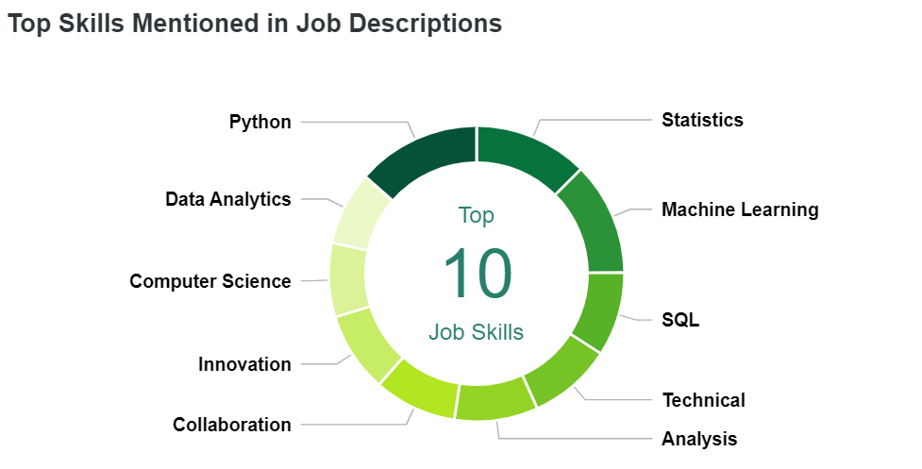
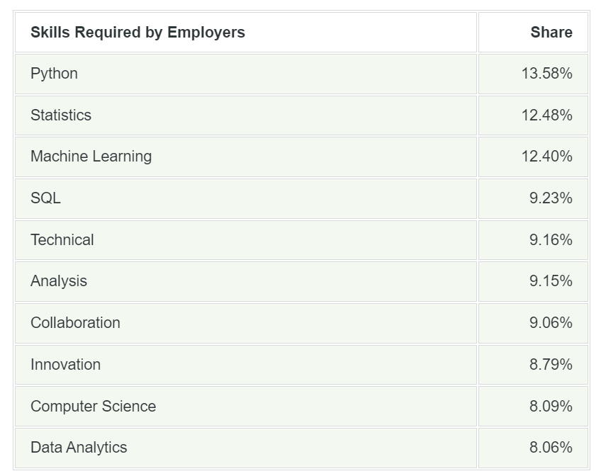
Data Science – Data Preparation
Skills of A Data Scientists
A report from Zip Recruiter's Marketplace Research Team has analyzed millions of job postings and resumes to identify the most important keywords related to Data Scientist jobs.
from Zip Recruiter
Notes:
Further Explanation
https://www.ziprecruiter.com/Career/Data-Scientist/Resume-Keywords-and-Skills
Employers require a broad range of skills and qualifications in their descriptions of Data Scientist positions. The top three keywords make up 38.46% of the total set of top terms. Look to the Resume Checklist below to see how Python, Statistics, and Machine Learning shares stack up against the share from resumes. SQL, Technical and Analysis represent an additionally healthy share of the employer Data Scientist job postings with their combined total of 27.54%. At 34%, Collaboration, Innovation, Computer Science, and Data Analytics appear far less frequently, but are still a significant portion of the 10 top Data Scientist skills and requirements according to employers.

Slide 37
Data Science – Data Preparation
Skills of A Data Scientists
In a blogpost, Mike Driscoll (Harvard alumni, entrepreneur, investor, ….) proposes "The three sexy skills of data geeks."
Statistics ("studying"), the most important and most difficult to master given its rigor and ever progressing recent development.
Data munging ("suffering"), the second most important referring to the "painful" process of cleaning, parsing, and proofing one's data before it is usable for analysis- real world data is messy. Whether it is cleaning, combining datasets, or making se of big data distributed storage systems data processing remains ever more important.
Visualization ("storytelling"), "the easiest to believe one has", although exposure to basic graphics is common to most data scientists, the ability to communicate ("narrate a story") to a wider and more general audience is a skill in itself!
Notes:
Further Explanation

Slide 38

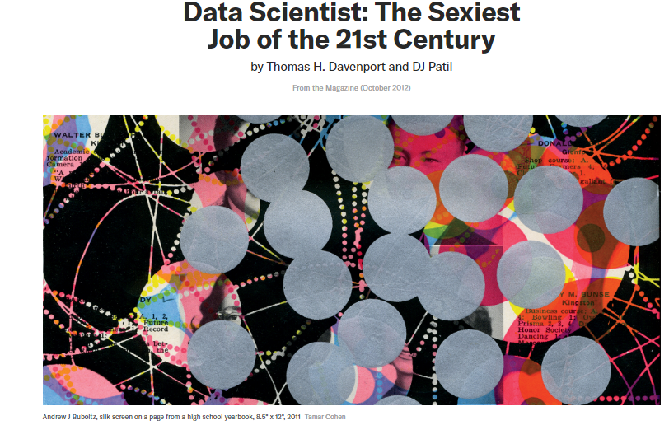
Data Science – Data Preparation
The "Sexiest" Job?
In 2012, under an HBR article, data science was dubbed "The Sexiest Job of the 21st Century."
Notes:
Further Explanation
https://hbr.org/2012/10/data-scientist-the-sexiest-job-of-the-21st-century
https://towardsdatascience.com/data-scientist-the-dirtiest-job-of-the-21st-century-7f0c8215e845

Slide 39


Data Science – Data Preparation
The "Sexiest" Job?
In 2012, under an HBR article, data science was dubbed "The Sexiest Job of the 21st Century."
"With all this cleaning, it doesn't seem too preposterous to dub data science as -The Dirtiest Job of the 21 Century."
Notes:
Further Explanation
https://hbr.org/2012/10/data-scientist-the-sexiest-job-of-the-21st-century
https://towardsdatascience.com/data-scientist-the-dirtiest-job-of-the-21st-century-7f0c8215e845

Slide 40
Data Science – Data Preparation
Is Pre-Processing Important?
"Often, data preprocessing is the most important phase of a (ds) (ml) project."
Analyzing data that has not been carefully screened and “cleaned” can produce misleading results given that that the models that a practitioner ends up using require meaningful data to correctly operate and to provide useful knowledge, predictions or descriptions.
“The representation and quality of data is first and foremost before running an analysis. If there is much irrelevant and redundant information present or noisy and unreliable data, then knowledge discovery is more difficult to conduct.”
Notes:
Further Explanation

Slide 41
Data Science – Data Preparation
Why is Pre-Processing Important?
The goal of preprocessing is a final dataset, which can be considered correct, useful and ready to be “fed” to models to discover interesting/meaningful relationships.
Before the original data can become the "official/final data" it must undergo processing-
Models (e.g. machine learning algorithms) expect numerical entries.
Different models have different requirements, often this comes in the form of assumptions, for example if a model expects an attribute to be from a particular distribution the data might need to be changed.
Model performance, as we have repeatedly stated- "Garbage in, Garbage out" bad data can only lead to bad results.
from Machine Learning Mastery
Notes:
Further Explanation
https://machinelearningmastery.com/data-preparation-is-important/

Slide 42
Data Science – Data Preparation
High Quality Data
Many different datasets, many different techniques, and far too many to enumerate in one setting, yet, at the core they all have high data quality. There is no particular process that fits all, instead one should attempt to have data that reflects sound principles.
Quality principles
Validity, the degree to which data conforms to defined business rules or constraints.
Accuracy, the degree to which the data is close to the true values.
Completeness, the degree to which all required data is known.
Consistency, the degree to which the data is consistent within the same dataset and/or across multiple data sets (same observation, conflicting information).
Uniformity, the degree to which the data is specified using the same unit of measure.
Notes:
Further Explanation
Accuracy vs Precision
https://en.wikipedia.org/wiki/Accuracy_and_precision
Quality Principles
https://en.wikipedia.org/wiki/Data_cleansing
https://www.tableau.com/learn/articles/what-is-data-cleaning

Slide 43
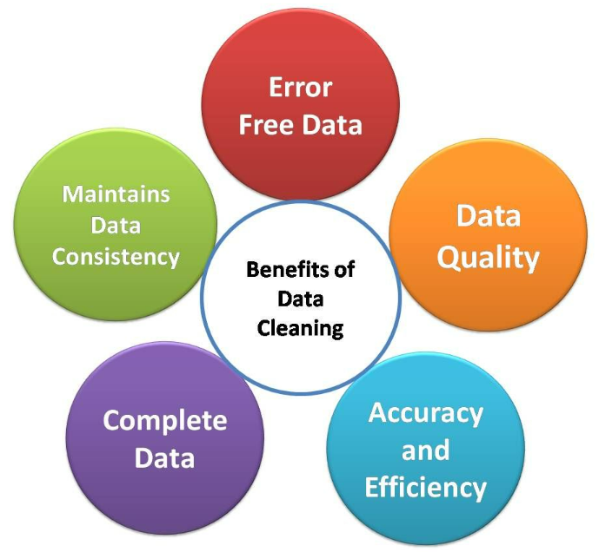
Data Science – Data Preparation
Benefits of Pre-Processing
from Analytics Vidhya
Notes:
Further Explanation
https://en.wikipedia.org/wiki/Data_cleansing
https://www.tableau.com/learn/articles/what-is-data-cleaning

Slide 44
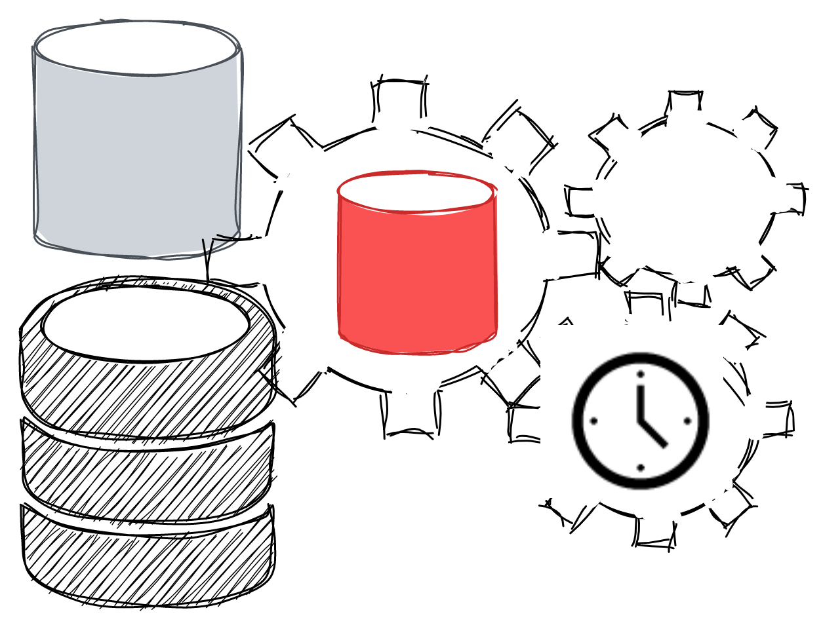
Data Science – Data Preparation
The Future of Preprocessing
As time progresses and the field of data science matures, some skills will become more valuable than others. Data munging will remain an important part of data science, but not of data scientists.
As reported in an HBR article, Mr. Nolis, a fortune 500 consultant, suggests that between an understanding of deep learning and that of the delivery of effective presentations, the latter seems destined to take the spotlight given the importance of communication to stakeholders.
In addition, automation is also increasing within data science, and as a result the time spent on dreaded tasks, such as that of data cleaning is bound to lower over time permitting the data scientist to focus on more pressing issues such insight discovery, effective communication, and ethical dilemmas which plague the current reality.
"The amount of time that a data scientist spends on data munging will decrease with the passing of time permitting them to focus on issues such as ethical dilemmas and communication."
Notes:
Further Explanation
- Trend of time spent on data munging is slowly decreasing
- This leads to "wasted" time and "unhappiness" in the job
- Although pre-processing is very important, over time this task will be picked by autonomous programs/agents, that will permit data
Scientists to focus on more pressing issues such as insights presentations and think about ethical dilemmas.

Slide 45
Data Science
Closing Remarks About the Data
1. Are the data observational or experimental? Are the data a sample of convenience or were they obtained via a designed sample survey. How the data were collected has a crucial impact on what conclusions can be made.
2. Is there nonresponse? The data you do not see may be just as important as the data you do see.
3. Are there missing values? This is a common problem that is troublesome and time consuming to handle.
4. How are the data coded? In particular, how are the categorical variables represented?
5. What are the units of measurement?
6. Beware of data entry errors and other corruption of the data. This problem is all too common — almost a certainty in any real dataset of at least moderate size. Perform some data sanity checks.
From "Linear Models in R" by Julian Faraway

Slide 46
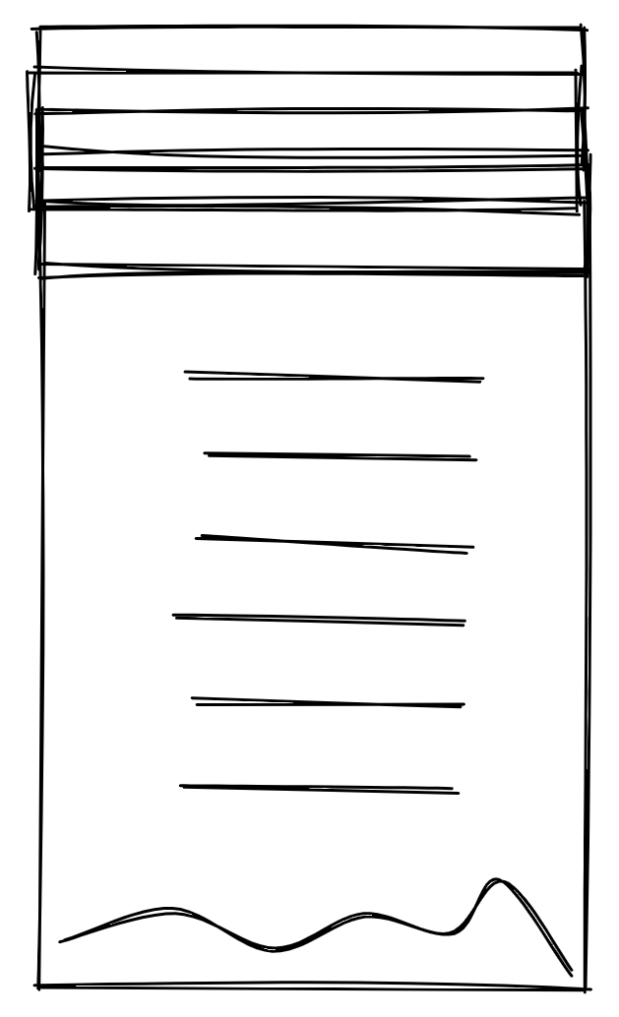
Data Science – Data Preparation
Further Resources
Studies
https://blog.ldodds.com/2020/01/31/do-data-scientists-spend-80-of-their-time-cleaning-data-turns-out-no/
https://www.datanami.com/2020/07/06/data-prep-still-dominates-data-scientists-time-survey-finds/
https://www.dataversity.net/survey-shows-data-scientists-spend-time-cleaning-data/
Skills
https://medriscoll.com/2009/05/27/the-three-sexy-skills-of-data-geeks/
Courses
https://www.coursera.org/learn/process-data/
https://www.coursera.org/learn/data-genes-medicine
Guides
https://scikit-learn.org/stable/modules/preprocessing.html
https://www.acaps.org/sites/acaps/files/resources/files/acaps_technical_brief_data_cleaning_april_2016_0.pdf
https://towardsdatascience.com/the-ultimate-guide-to-data-cleaning-3969843991d4
https://towardsdatascience.com/data-preprocessing-e2b0bed4c7fb
https://www.analyticsvidhya.com/blog/2021/08/data-preprocessing-in-data-mining-a-hands-on-guide/
https://learn.g2.com/data-preprocessing
Notes:
Further Explanation

